Slide 1
In-Memory Computing
Seth Ricks, Ian McMaster, Emily Sammons, Jonas Norwood

Slide 2
Overview
What is In-memory computing?
What is the problem it is solving?
Methods used
Applications
Challenges
Test questions

Slide 3
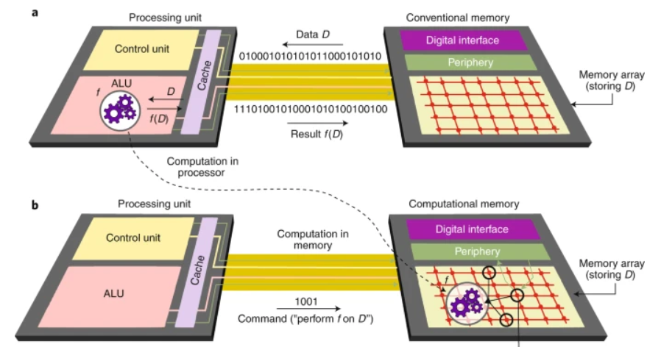
What is In-Memory Computing?
“IMC … [is] where memory is not only storing data but can also directly output computation results.” (Paper from Association of Computer Machinery)
Perform computations directly in memory instead of just storing information.
Addressing “memory wall” (CPU has grown much faster than memory speeds)
Helps save energy with less data movement.
Sebastian et al., Nature Nanotechnology, 2020

Slide 4
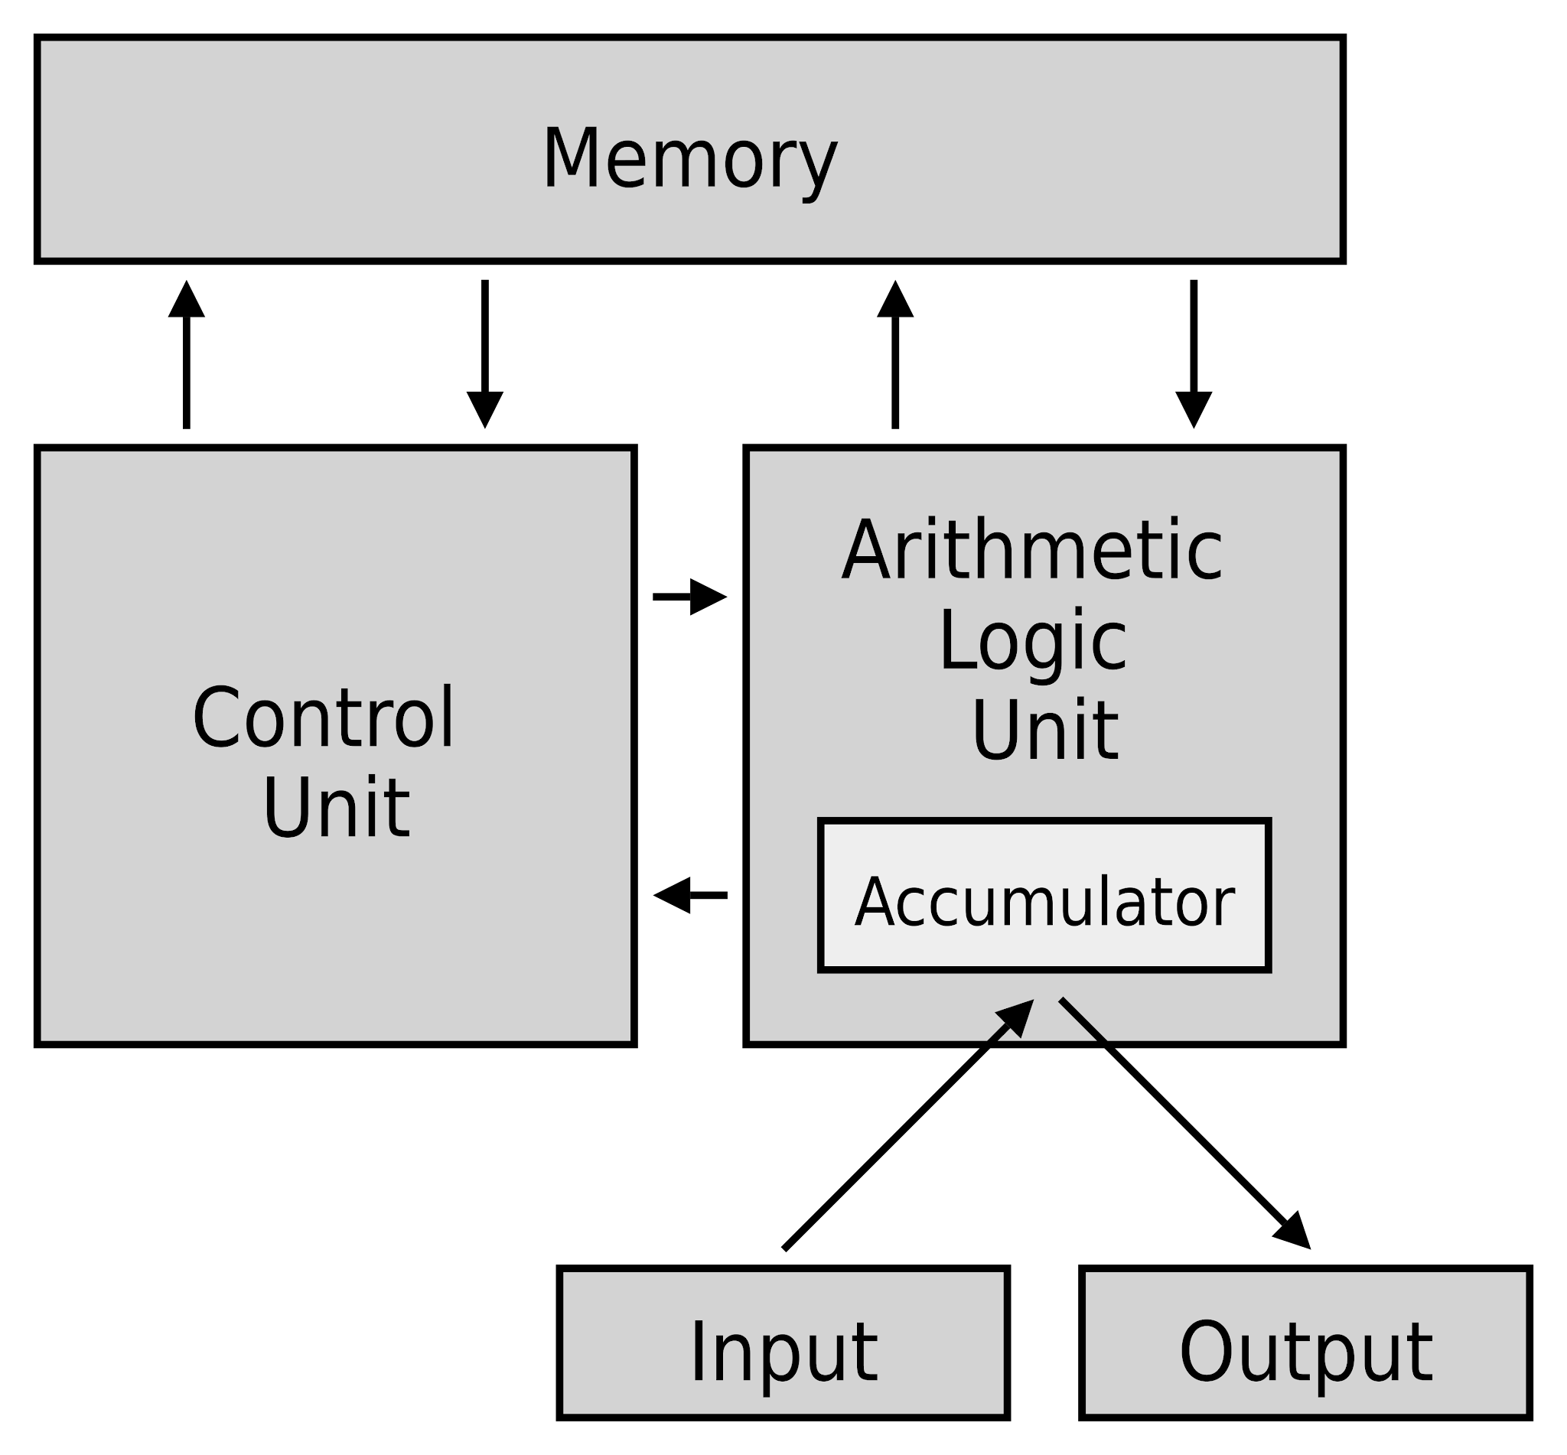
What is the problem is it solving?
The Von-Neumann computer model relies heavily on memory.
Passing data to and from memory is power and time demanding.
Cpu’s have improved a lot, and memory has improved less.
AI has made this more apparent as the AI models use lots of memory.
(Figure from Digikey)

Slide 5
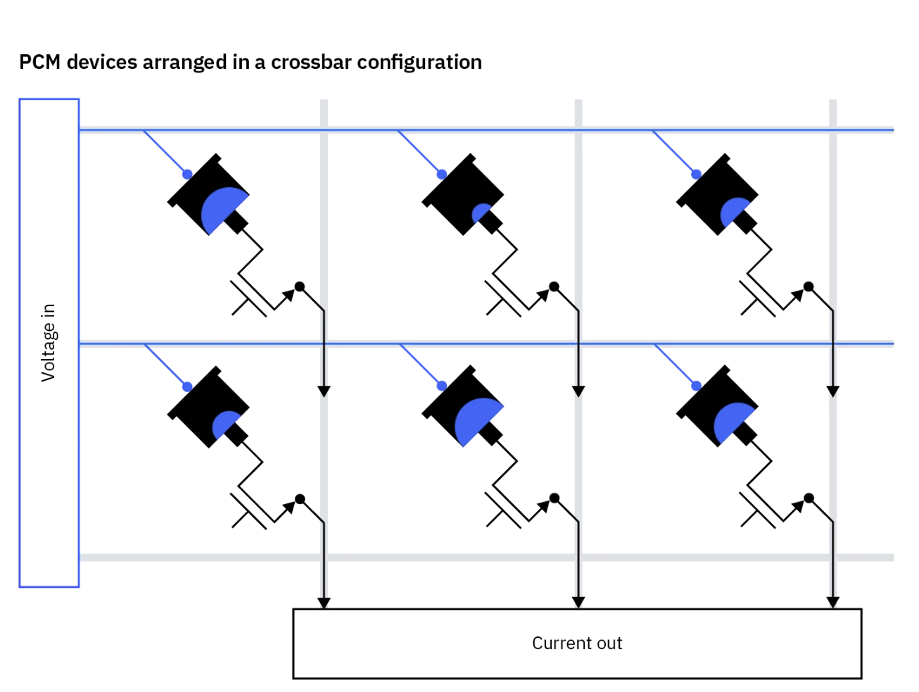
PCM Devices - A Method of In-Memory Computing
PCM devices use Ohm’s and Kirchhoff's Laws to do matrix multiplication.
“Moving 64 bits of data from DRAM to CPU consumes 1-2nJ, which is 10,000–2,000,000 times more energy than is dissipated in a PCM device performing a multiplication operation (1-100fJ).” (Le Gallo-Bourdeau)
(Figure from IBM)

Slide 6
Potential Applications
Neural Network Computations (AI)
AI processes large amounts of data
IMC would decrease computation time
Signal Processing
Complex signal chains could travel through memory
Stochastic Computing*
Benefits from data being closer to computation
Security (Cryptography, hashing, etc.)
Solving Differential Equations
*Probability based computing
(All computation can gain efficiency since there would be less memory transfers)

Slide 7
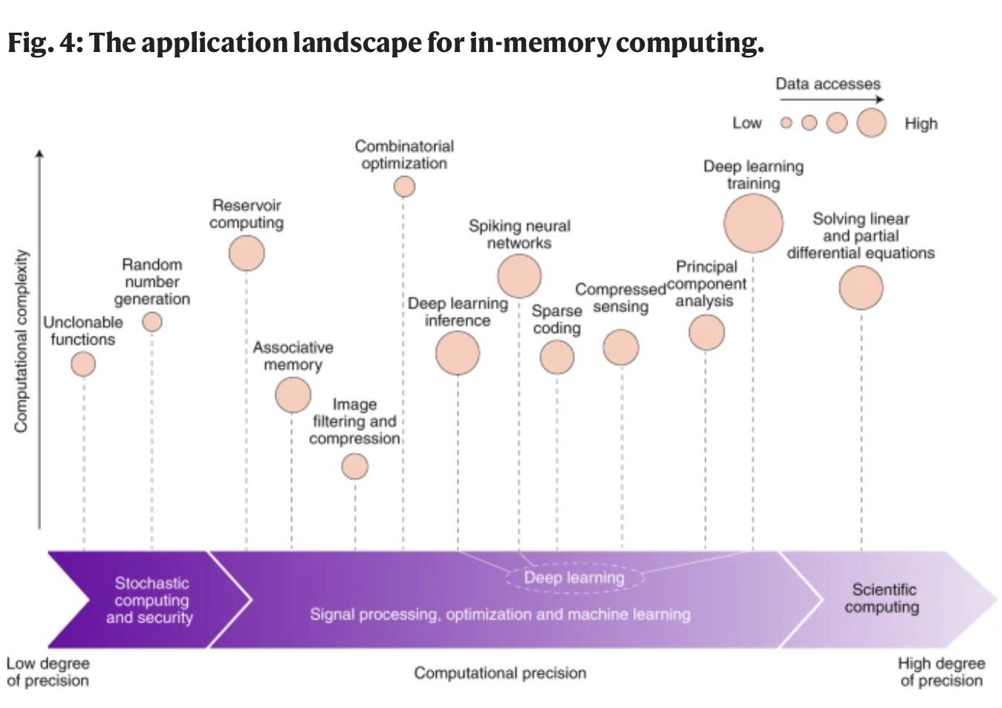
Memory devices and applications for in-memory computing - Nature Nanotechnologies (July 16 2020)

Slide 8
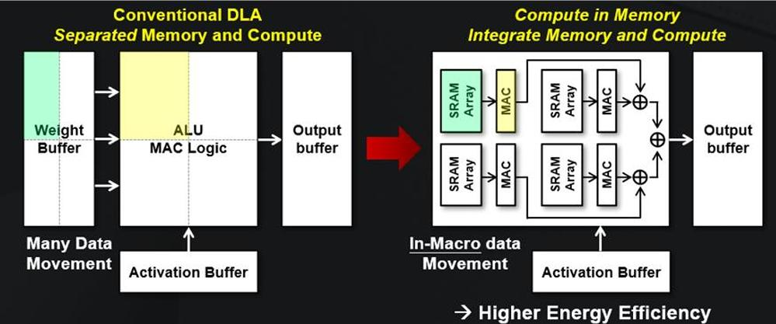
Challenges of In Memory Computing
Integration
Memory chips are optimized for density instead of logic like previous models.
Coding is optimized for Von - Neumann architecture,
Existing systems (SAP HANA)
Functions
Currently not a full CPU replacement (simple arithmetic vs floating point)
Data consistency and Cache coherence
Precision of analog computing
New, faster memory is expensive to manufacture, ReRam, MRam, etc.
PIM introduces new side channels for attacks

Slide 9
Research
Overview
https://www.nature.com/articles/s41565-020-0655-z
Currently being researched for AI applications:
A Heterogeneous and Programmable Compute-In-Memory Accelerator Architecture for Analog-AI Using Dense 2-D Mesh | IEEE Journals & Magazine | IEEE Xplore
Using the IBM analog in-memory hardware acceleration kit for neural network training and inference | APL Machine Learning | AIP Publishing
Hardware-aware training for large-scale and diverse deep learning inference workloads using in-memory computing-based accelerators | Nature Communications
A 64-core mixed-signal in-memory compute chip based on phase-change memory for deep neural network inference | Nature Electronics
In-memory factorization of holographic perceptual representations | Nature Nanotechnology
In Memory Computation With Phase Change Memory:
Projected Mushroom Type Phase‐Change Memory - Ghazi Sarwat - 2021 - Advanced Functional Materials - Wiley Online Library

Slide 10
Test Questions
Why is In-Memory Computing being explored?
To reduce the number of transistors used in memory.
To reduce the time and power spent moving data between the CPU and memory.
To save space on the motherboard by removing cache.
To make register-to-register transfers faster.
2.) True / False
DRAM to CPU transfers can consume 10,000–2,000,000 times more energy than what is dissipated by other solutions doing the matrix multiplication operation in memory.

Slide 11
Test Questions
3.) True / False
Memory has improved at the same rate as CPU’s.
4.) Select All That Could Benefit From In Memory Computing:
Artificial Intelligence
Signal Processing
Low Memory Applications
Solving Differential Equations
None of the above

Slide 12
Citations
Y. Ma, Y. Du, L. Du, J. Lin, and Z. Wang, “In-memory computing: The next-generation AI computing paradigm,” in Proc. ACM Great Lakes Symp. VLSI (GLSVLSI ’20), Virtual Event, China, Sep. 2020. doi: 10.1145/3386263.3407588.
Tian, P. H., Yousefijamarani, Z., & Alameldeen, A. (2025, October 9). DL-PIM: Improving data locality in processing-in-memory systems. arXiv.org. https://arxiv.org/abs/2510.07719?utm_
Kaur, R., Asad, A., & Mohammadi, F. (2024, July 16). A comprehensive review of processing-in-memory architectures for deep neural networks. MDPI. https://www.mdpi.com/2073-431X/13/7/174
Chen, W., Qi, Z., Akhtar, Z., & Siddique, K. (2022, November 9). Resistive-RAM-based in-memory computing for neural network: A Review. MDPI. https://www.mdpi.com/2079-9292/11/22/3667

Slide 13
Additional Citations
M. Le Gallo, “The hardware behind analog AI,” IBM Research Blog, Nov. 20, 2021. [Online]. Available: https://research.ibm.com/blog/the-hardware-behind-analog-ai
IBM Technology, “What is In-Memory Computing?,” YouTube, [Online]. Available: https://www.youtube.com/watch?v=BTnr8z-ePR4
Asianometry, “AI’s Hardware Problem,” YouTube, [Online]. Available: https://www.youtube.com/watch?v=5tmGKTNW8DQ
Veritasium, “Future Computers Will Be Radically Different (Analog Computing),” YouTube, [Online]. Available: https://www.youtube.com/watch?v=GVsUOuSjvcg
Forbes, “Efficient AI Inference With Analog Processing In Memory,” YouTube, [Online]. Available: https://www.youtube.com/watch?v=b1F1h1U3vvs

